Slide 1

Improving the Developer Workflow
Notes:
Hi and welcome to this module on Improving the Developer Workflow.
In this module we are going to follow the 6 steps of Developer Workflow and briefly talk about the tools and techniques you can use in all these phases

Slide 2
What is Developer Workflow
Setup
Setting up your local development environment, creating backlogs, downloading libraries
Develop
Writing code
Test
Testing your code locally and see if things work
Integrate
Merge your code with the rest of your team
Optimize
Prepare assets for deployment to production
Deploy
Push code and assets to production
source: https://zellwk.com/blog/workflow-overview/
Notes:
To work effectively, a good workflow is crucial. An optimized development workflow saves you time and money, but, more importantly, it allows your developers to focus on the important tasks. The software that needs to be produced. And above all, a good developer workflow allows for more fun at work. No more time spent on dull repetitive tasks but a nice and smooth way to get your things done. We know this, and yet we constantly procrastinate this important task.
When we want to optimize our developer workflow, we can look at 6 phases. These 6 phases all focus on reducing toil, which is the time spent on repetitive tasks that do not add any business value. Let us go through the different phases
The first phase is the Setup phase. This is where you setup your local development environment. You’ll create a git repository, setup your IDE, download libraries and tools and configure your settings to make sure you have everything in place before you start writing code.
Then the Develop phase. This is where you probably spend the most of your time - writing code! You get a task, write Code, Commit to the Git Repo, and collaborate with your co-workers
In the Test phase you validate if your code works locally and refine where needed.
In the Integrate phase you merge your code with the rest of your team. This usually involves merging git branches via pull requests
During Optimize You prepare all your assets for use on the production server. Performing security scans and creating packages is an important tasks during this phase.
During Deployment you can push your code and assets up to the server and allow changes to be viewed by the public.
https://zellwk.com/blog/workflow-overview/

Slide 3

Developer Workflow
Setup
GitHub Codespaces
Azure Boards
Notes:
The first phase is Setup.
Although there are many things that can be improved in the setup phase, the 2 things that always take a lot of time is getting your IDE up and running for all team members, and make sure that everybody on the team knows what to work on.
GitHub Codespaces can help in setting up a full featured IDE in the cloud that is the same for everybody.
Azure Boards can give you a flexible and easy way to visualize the work at hand and integrate that with the source code changes

Slide 4
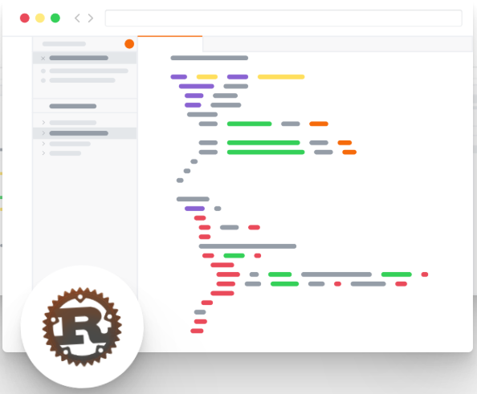
What is GitHub Codespaces?
Codespaces is an online development environment, hosted by GitHub and powered by Visual Studio Code, that allows you to develop entirely in the cloud.
Full powered IDE (Syntax highlighting, auto-complete, debug tools etc.)
Kickstart your developers with pre-installed IDE
Configuration is part of the Git Repository
Develop everywhere
Notes:
GitHub Codespaces is an online development environment hosted by GitHub.
CodeSpaces can run entirely from within the browser and provide you with a full featured VS Code IDE.
CodeSpaces uses Docker as an underlying technology to allow you to build a development machine as an immutable container image. Docker images, combined with configuration files, allows you to fully script the IDE for your project.
The IDE configuration is part of your Git Repository and accessible by all your team members. When a new team member joins, it is a matter of pushing a button to get started with the right tools, settings and extensions. And, because it runs in the cloud, you can access your IDE anywhere

Slide 5
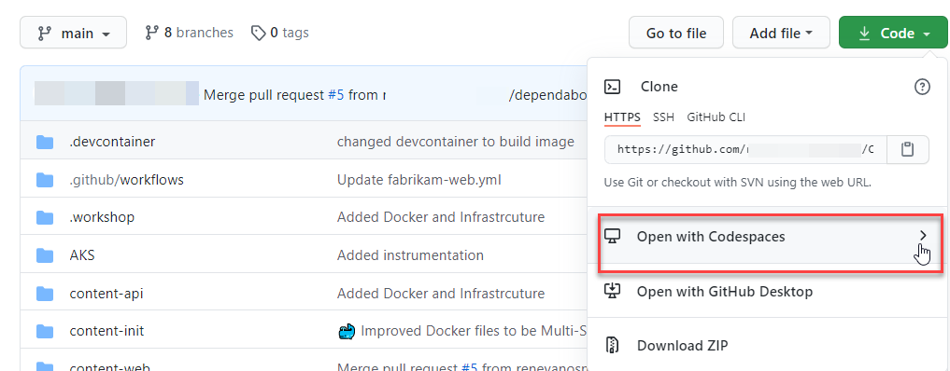
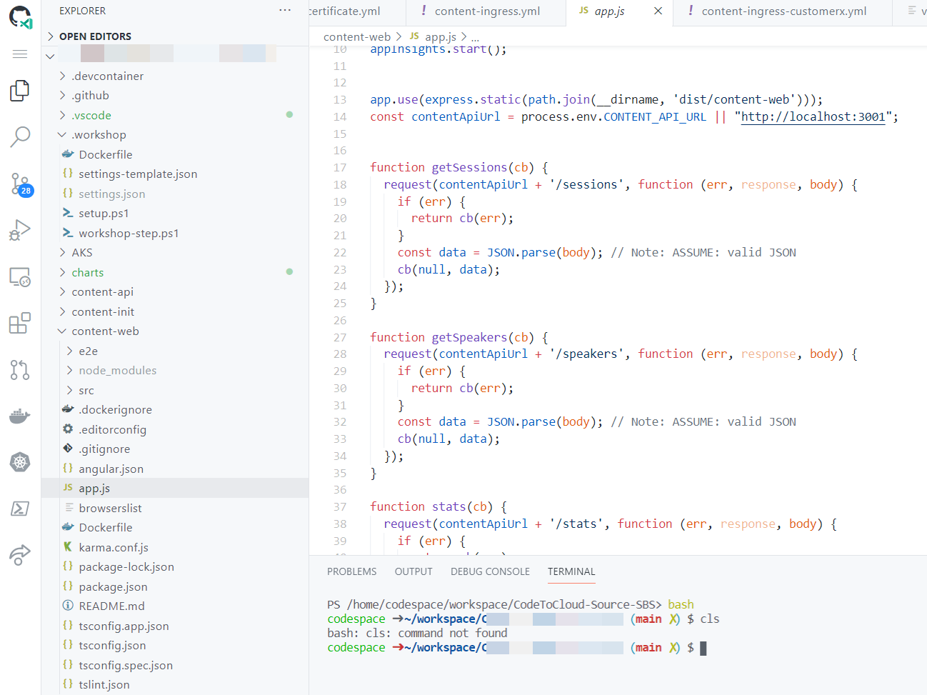
Notes:
As an example, In this screen you can see how easy it is to connect to your Codespace and get Started right away with Visual Studio Code in the Cloud, completely preconfigured

Slide 6
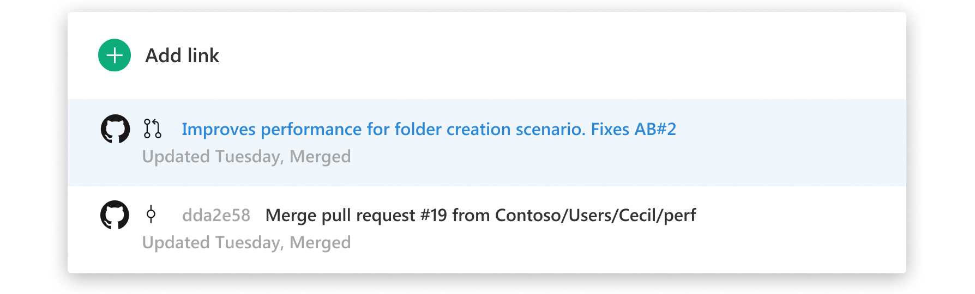
What is Azure Boards
Tool to visually track and plan work across multiple teams
Part of Azure DevOps
Can be fully integrated with GitHub
Fully customizable
KanBan, Scrum, Agile or you own workflow
Notes:
In any project, the team needs to know what to work on. And especially with distributed teams and remote work, sticky notes on a physical wall are not always enough.
Furthermore, in many cases it is required to create an audit trail of changes. Work that has been done, related to the actual changes in the source code.
One of the tools that is very competent in doing this is Azure Boards. Azure Boards is part of Azure DevOps and support a wide number of Process templates that can be used to track work. Scrum, Agile, KanBan, CMMI etc..
Azure Boards allows your to plan items visually via an Scrum or KanBan boards. Thanks to the tight integration with GitHub you can relate source code Commits to work items. When you do this, this is visible in both Github as in Azure Boards.

Slide 7
Developer Workflow
Develop
GitHub Codespaces
Visual Studio Code
GitHub Flow. Make a branch
Notes:
The second phase in our development workflow is the development phase. In the development phase code and scripts is produced.
To reduce noise and bugs, it is advisable that all developers have a similar setup of their development environment. As explained earlier, GitHub Codespaces can facilitate this, by making the IDE part of the repository and allowing all developers to get started right away.
On the backend Codespaces uses Visual Studio Code. You can run VS Code locally, but you can also load the GitHub Codespace on your local PC.
To share code amongst the developers in the team, we use GitHub as Source control system. But is does not stop with sharing code. Developers also collaborate on code to make it better. For that we can use the GitHub Flow

Slide 8
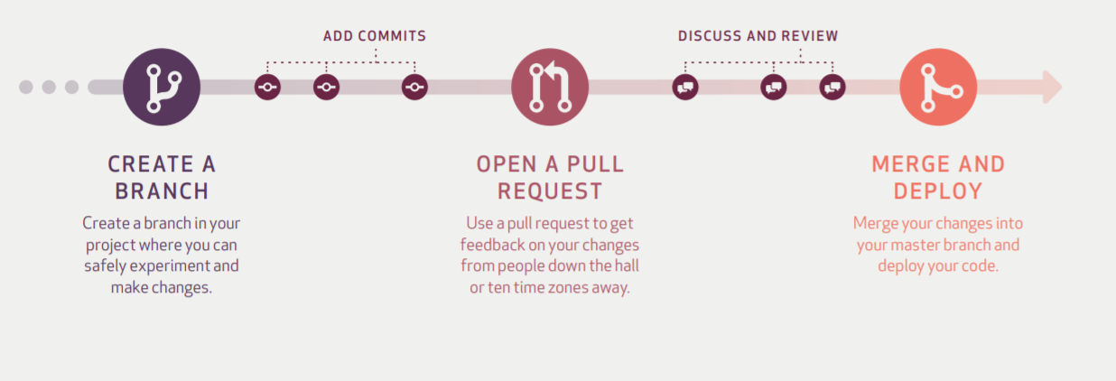
GitHub Flow
main
Notes:
The GitHub Flow is a lightweight, branch-based workflow. It works quite easy and when you work with GitHub this is fully supported in the toolset.
When a developer starts work, he or she creates a branch. All changes will be done onto this branch to keep them isolated from the working copy, the main branch.
When the code is in a state that it can be shared, the developer creates a Pull Request. This is a mechanism within GitHub where other people can look at the changes, comment on them, and give feedback.
When the code looks ok, the code can ben merged to the main branch to be available in the deployments .
https://guides.github.com/pdfs/githubflow-online.pdf

Slide 9
Developer Workflow
Test
Testing Locally
Using Docker to quickly create production like environment
Notes:
When it comes to testing software, everybody knows the phrase, “it works on my machine”. But that is actually not a good thing.
Testing locally is crucial, but making your local environment similar to production is hard. One of the technologies that can be used to overcome this issue is Docker.
Docker is the industry standard when it comes to containers . Docker allows you to build a container image, which is a predefined set of tools, configuration, scripts and settings on 1 machine, and run the image on any machine with the same OS.
This means that when a container image is created on a developer machine, the same container image can be used on production without changes.

Slide 10
Running Containers on Linux
Isolation from
kernel-level
container support
Binaries depend on specific OS/kernel
No guest OS needed
Containers are started from images
Container A
Container B
Container C
App 1 Binaries/Libraries
App 2 Binaries/Libraries
App 3 Binaries/Libraries
Linux-based Host Operating System
with container support (e.g. Debian)
Infrastructure Host server (physical or virtual)
Notes:
Before we talk about Docker, let’s give a little bit of background on containers.
The easiest way to explain containers, is to start thinking about a Virtual Machine. A Virtual Machine is a machine that runs within another Computer. The virtual machines use virtualized hardware. Other than that, it is the same as a physical machine. They need their own OS and drivers etc.
A container does not run on virtualized hardware. It runs on the existing OS and uses the same processes and drivers, but in isolation. Storing only the changes from the host OS. This means you cannot run a Windows Container on Linux and vice versa.
Because a container does need its own OS, they are small and fast. And because they are small, you can run many container instances on one host.

Slide 11
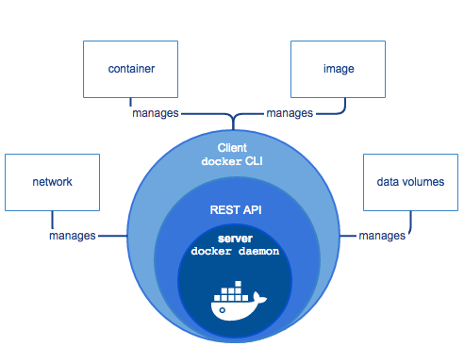
What is Docker?
Notes:
And then Docker.
Docker is an open platform for developing, shipping, and running applications.
Docker consists of a few components. The Docker Daemon which is the communication engine between host machine and container, A REST Api to interact with the daemon and the Docker CLI. The CLU uses the API in a user friendly way to allow users to work with docker

Slide 12
Container anatomy
Container Images
The Container
Container Tooling
Container layer (Thin r/w)
Your Application
Updates / Patches / Additional tools
Frameworks and Tools
Base OS layer
Notes:
When we talk about docker and containers then we also need to talk about images, since a container is the running instance of a container image.
Lets first take a look at what an image is.
To run a container, we need an image. An image consists out of several layers. The first layer of an image is always the base operating system layer. This is where all the required files are that are needed together with the shared operating system kernel to provide the operating system services.
On top of the operating system layer, you can create new layers. Each layer is a delta added to the base layer. This means e.g. that if I would like to have a container running NGINX, we need to add a layer that installs this.
After you commit the changes to the new image, you can use this image as the starting point of a new image that .e.g. adds the NODEJS capabilities on top of that. This way you constantly add layers to the images, until you have a container that is fully capable of running your own application
The container is a running instance of the image. This means the operating system adds a thin read/write layer on top of the container image.
The nice thing about a container is that when you stop it and start a new instance, you always start from that clean image. This way you never pick up any changes on the image, ensuring there is no drift in e.g. configuration.
We call this the immutability of the image. Once you created an image, you can not change it. Changing it means you create a new image.

Slide 13
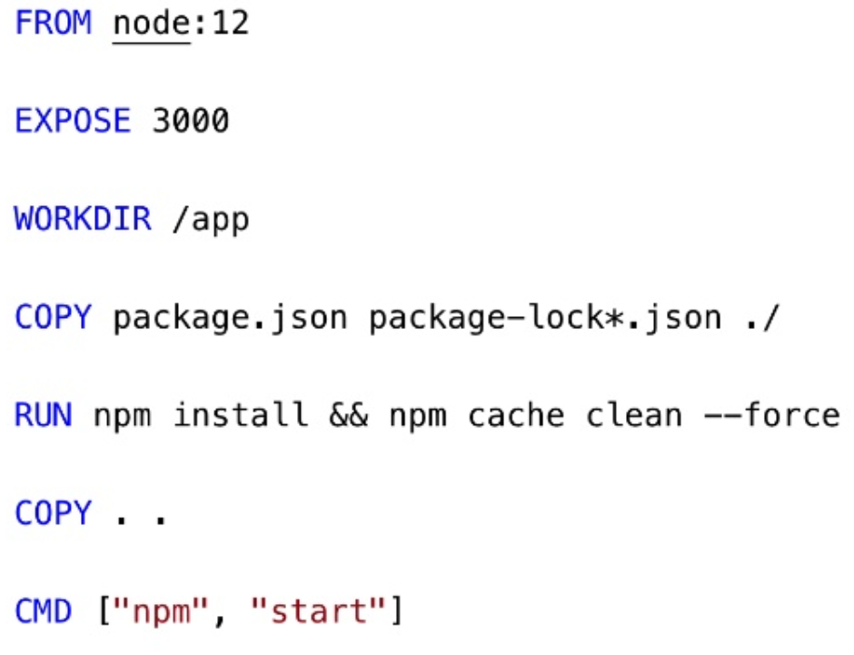
Dockerfile to create images
Notes:
The great part about Docker is that you can do everything as code.
Either by running commands in the Docker CLI or by creating Docker Files that describe how a container image should look like.
In the example, you can see that the Docker file builds on top of a node base images, exposes a port 3000, creates a new directory and then copies files and runs NPM install,
When running a Docker build command, the Docker file is executed and the immutable image is created.

Slide 14
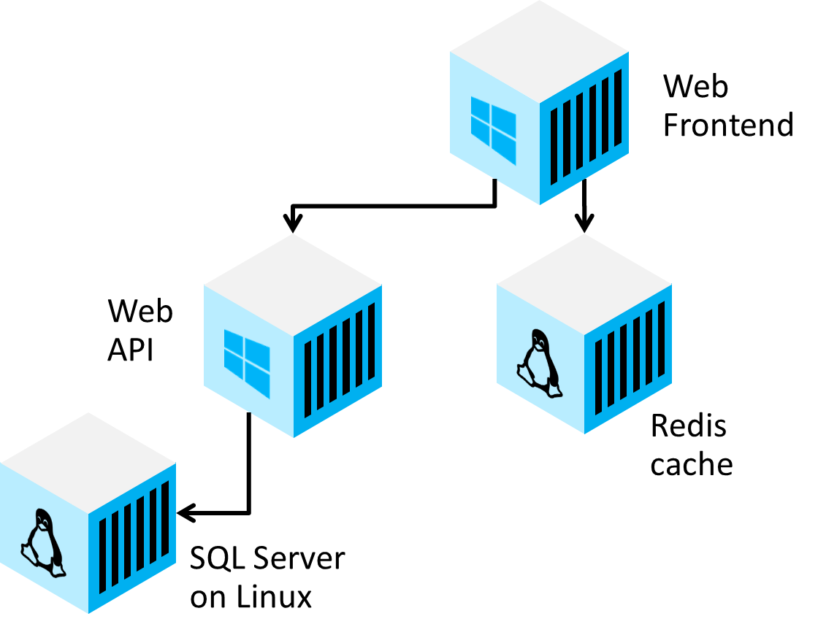
What is Docker Compose?
Used to instance multiple containers
Can reference Dockerfiles and/or images
Paired with docker-compose.yml
Notes:
When an application consists of multiple parts (e.g. an API, Web application and database) you need to run all containers at the same time and connect them in a network.
To facilitate orchestration of multiple containers you can use Docker-compose. Docker-compose allows you to describe a composition that uses either existing container images or builds them om the fly using the already created docker files

Slide 15

Docker-compose structure
version: '3.0'
services:
service-name:
image: docker-image
build: how to build
depends_on:
- other services
environment:
- key/value pairs
ports:
- port mappings
networks:
network-name:
volumes:
volume-name:
Notes:
Docker compose files are described in YAML where you can specify both the build and run parameters

Slide 16
Developer Workflow
Integrate
Pull Requests to review code
Continuous Integration with GitHub Actions
Notes:
When all work is done and the software has been tested, you can integrate it with the rest of the sources in the main branch.
You saw earlier that GitHub Flow and Pull Requests can be used to facilitate this process.
To do final checks and to get quick feedback if your code works together with the code that other developers produced, it is wise to set up an Continuous Integration Build. A Continuous Integration build gets the latest version from your source control system and then compiles and builds the software.
This way all errors that might occur due to merging can be detected early. For that you can use GitHub Actions

Slide 17
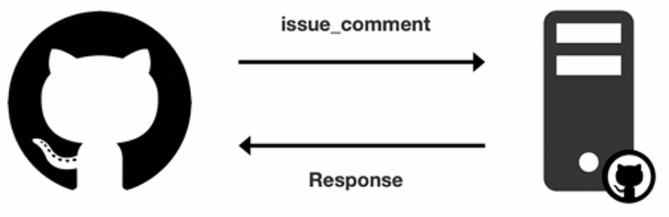
GitHub Actions
Repository automation by listening to events (commit, issue_comment, etc.)
Commonly used for CI/CD
Marketplace with actions or build your own
Runs on Mac, Linux and Windows
Notes:
GitHub Actions is the automation engine in Github that allow you to automate things based on events.
For example the commit event, or the Pull Request closed event.
A common use case is CI/CD where every commit will trigger a build.
The build is a set of automated steps to perform actions. You can write your own actions or find actions in the GitHub Marketplace.
By putting actions in a workflow you create a GitHub action workflow that is executed on a agent running either locally or in moist cases n the cloud on all platforms.

Slide 18
Developer Workflow
Optimize
Create immutable packages
GitHub Packages
Security Scanning
Notes:
After integration it is time to optimize your code . In some cases you need to create shared libraries or docker images. For that you can create packages, or when using Docker, immutable container images.
These immutable packages should be stored in a central repository that can be accessed by your team or even by the whole world.
GitHub packages is a package repository that allows you to store all kinds of packages like maven, docker and Nuget.
Furthermore you want to perform Security Scanning before deploying anything to a server. Check if your code, or some of the libraries you use doe not contain known vulnerabilities.

Slide 19
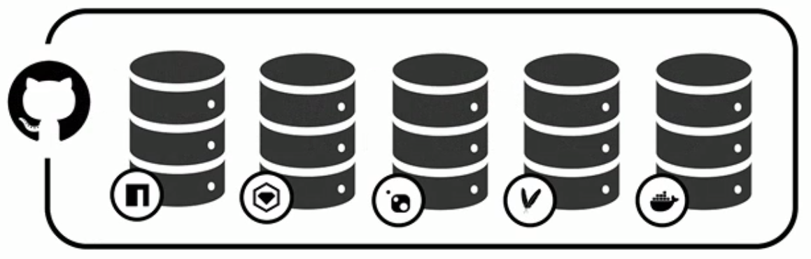
GitHub Packages
Private and public repositories for a number of technologies like NPM, Docker, RubyGem, Nuget, Maven and more
Notes:
GitHub packages is a repository that allows you to store packages of many different technologies.
You can create your own package repository and make packages either privately visible or public. By connecting to the repository people can download the packages or container images and directly get started with their work.

Slide 20
GitHub Security
Integrated security into your repositories
Compare dependencies against vulnerability database
Alerts when vulnerable packages are found
Automated fixes with GitHub Actions by DependaBot
Security scanning available as GitHub Action to shift left Security
Notes:
GitHub Security consist of multiple components and will even expand further in the future.
It allows you to scan your code for known vulnerabilities and alerts when vulnerabilities are found. DependaBot, one of the features, even creates pull request with automated fixes when vulnerabilities are found. This allow you to shift security left

Slide 21
Developer Workflow
Deploy
GitHub Actions
Azure Pipelines
Notes:
For deployment there are multiple options that can be used.
We already covered GitHuB actions. GH Actions van be used for deployment, simply by adding deployment actions to the workflow.
You can also choose to use Azure Pipelines which is part of Azure DevOps. There is string integration between both platforms. Azure DevOps also has the possibility to create release pipelines..

Slide 22
Improving the Developer Workflow
Summary
Developer Workflow
GitHub Codespaces
Docker and Docker-Compose
GitHub Flow and Pull Requests
GitHub Actions
GitHub Packages
GitHub Security
Notes:
To Summarize.
You have learned about the developer workflow and the six phases where you should optimize. About GitHub code space, a full featured IDE in the cloud and about Docker and Docker compose and how this can help you to create portable and stable production like environments. You also learned about the GitHub Flow and how Pull Requests play a big part in this flow to improve developer collaboration. We saw how GitHub actions can help you to create a CI/CD workflow that can push packages to GitHub packages so other people can reuse it is an easy manner. And finally we touched upon the GitHub security features that allow you to shift security left.
This concludes the modules on improving developer workflow.

